Slide 1
A Machine Learning Framework for the Food & Beverage Industry
David Abrams

Slide 3
Work Flow
Scrub and Munge Data
K-Means Clustering
Dimensionality Reduction:
Non-Negative Matrix Factorization

Slide 4
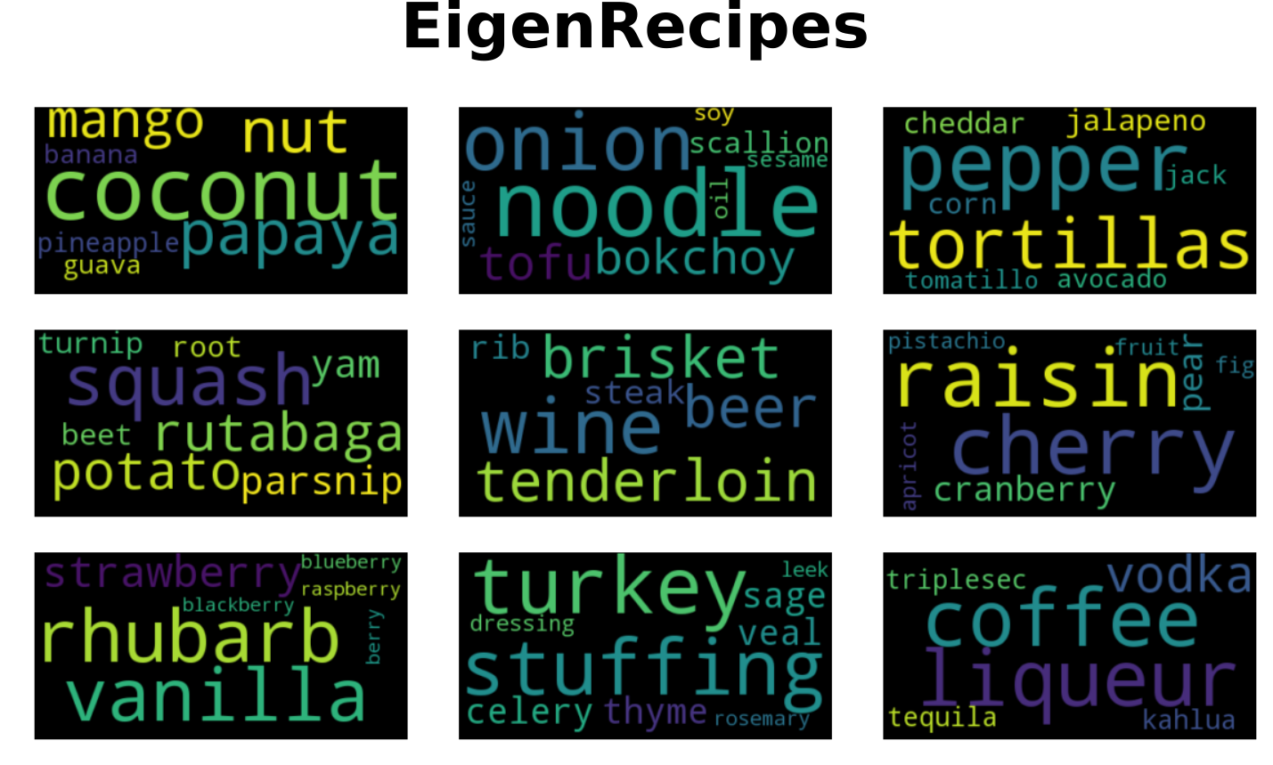
Prototypical Recipes

Slide 5
Work Flow
Scrub and Munge Data
SVM Classifier
Dimensionality Reduction:
Principal Component Analysis

Slide 6
Cuisine Classifier
Classification Accuracy (%)
Cuisine Classification Predictions

Slide 9
A Machine Learning Framework for the Food & Beverage Industry
David Abrams

